Slide 1
Automated Expense Categorization System
PROJECT 4 JUDY PIN
XUAN(SAM) CHEN
GIFTY APPIAGYEI

Slide 2
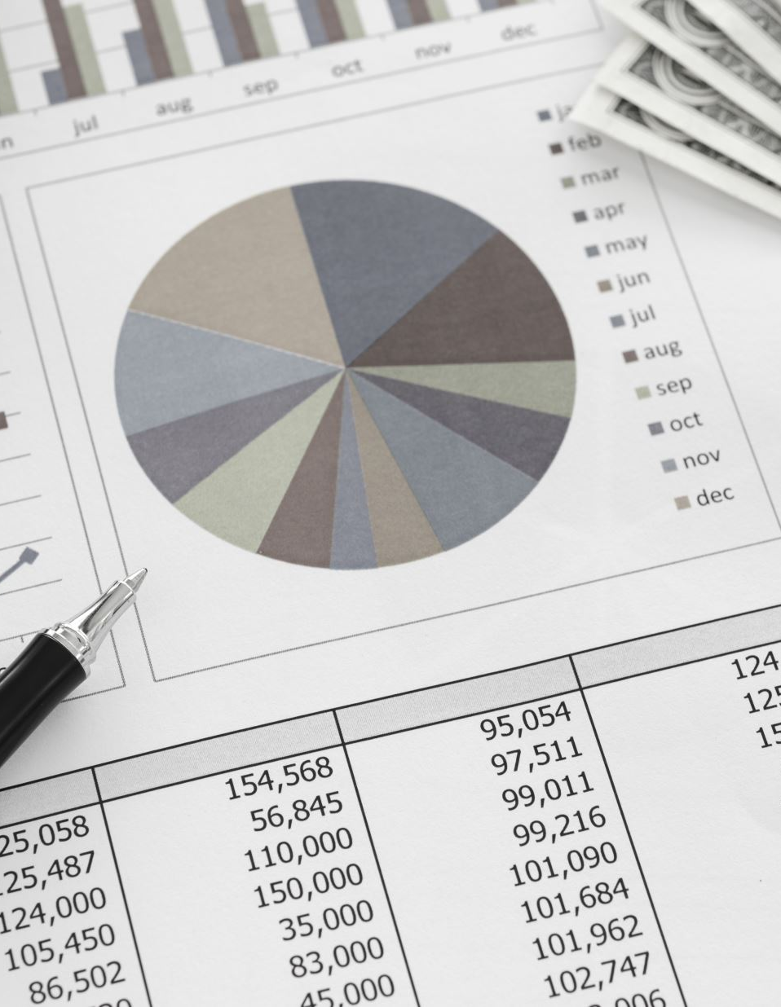
Overview
Although finance is an essential function in every company, finance teams spend too much time gathering data, staring at spreadsheets, completing the close, and generating reports.
Digital tools can reduce and even eliminate these tasks, freeing up finance to add more value as a strategic business partner.

Slide 3

Ethical Considerations for Data Privacy
Data Privacy: Sensitive data was removed and anonymized to protect individuals and vendors.
Transparency: All processes and predictions made by the system are transparent, with clear documentation on how data is handled.
Security: Data encryption and strict access protocols were implemented to ensure data security.

Slide 4

The Problem with Manual Expense Categorization
Time-consuming process
Human errors
Delayed decision-making
High operational costs

Slide 5
An Automated Approach to Expense Categorization
Objective
Technology
Outcome

Slide 6
Building the Automated Expense Categorization System
Data Collection and Preprocessing
Model Development
Integration with Frontend
Notes:
Judy 3 steps

Slide 7

What Businesses Gain
Efficiency
Accuracy
Scalability
Cost Savings

Slide 8

Model Performance
Decision Tree Model: Accuracy of 0.44.
Random Forest Model: Accuracy of 0.99.
Deep Learning Model: Accuracy of 0.99.

Slide 9

User Interface and Real-Time Predictions
Simple, accessible interface using Streamlit.
Real-time prediction and categorization of expenses.
Immediate feedback on transaction categorization

Slide 10
Revolutionize Your Financial Operations Today
For Businesses: Embrace automation and optimize your financial processes today. Contact us for a demo and explore how the system can be tailored to your needs.

